Slide 1
Lecture 3
CSC 2310
Dr. Shah Alam

Slide 2
Lab 2 Topics
Creating/Instantiating Objects and passing parameters to them
Instantiating Objects through other classes
Constructors
Javadoc
Java API
Casting (will be covered in another lecture, the basic idea is same as C/C++)
Creating Static Methods (already covered in the last lecture)
has-a/is-a relationship between objects
Using Java jar files
Import statement within the file
compiling/running with -cp
Recursion (Will be covered in the lab. It’s same as C/C++)

Slide 3
Creating/Instantiating Objects and passing parameters Instantiating Objects through other classes
Example code: BoxPass.java

Slide 4
Constructors
A constructor is a special kind of method that is designed to initialize the instance variables for an object:
public ClassName(anyParameters){code}
A constructor must have the same name as the class
A constructor has no type returned, not even void
Constructors are typically overloaded

Slide 5
Constructors
A constructor is called when an object of the class is created using new
ClassName objectName = new ClassName(anyArgs);
The name of the constructor and its parenthesized list of arguments (if any) must follow the new operator
This is the only valid way to invoke a constructor: a constructor cannot be invoked like an ordinary method
If a constructor is invoked again (using new), the first object is discarded and an entirely new object is created
If you need to change the values of instance variables of the object, use mutator methods instead

Slide 6
You Can Invoke Another Method in a Constructor
The first action taken by a constructor is to create an object with instance variables
Therefore, it is legal to invoke another method within the definition of a constructor, since it has the newly created object as its calling object
For example, mutator methods can be used to set the values of the instance variables
It is even possible for one constructor to invoke another

Slide 7
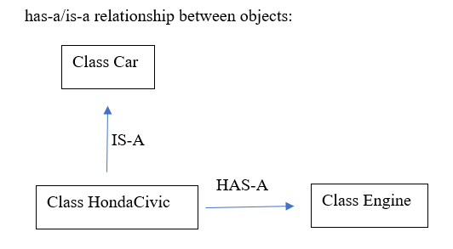
IS-A & HAS-A Relationship
Faculty
IS-A
Class CSFaculty
HAS-A
Students

Slide 8
Javadoc & Java API
See the documentation on Matrix
You must learn how to interpret any documentation

Slide 9
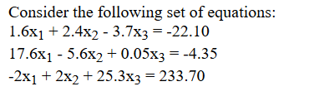
Exercise

Slide 10
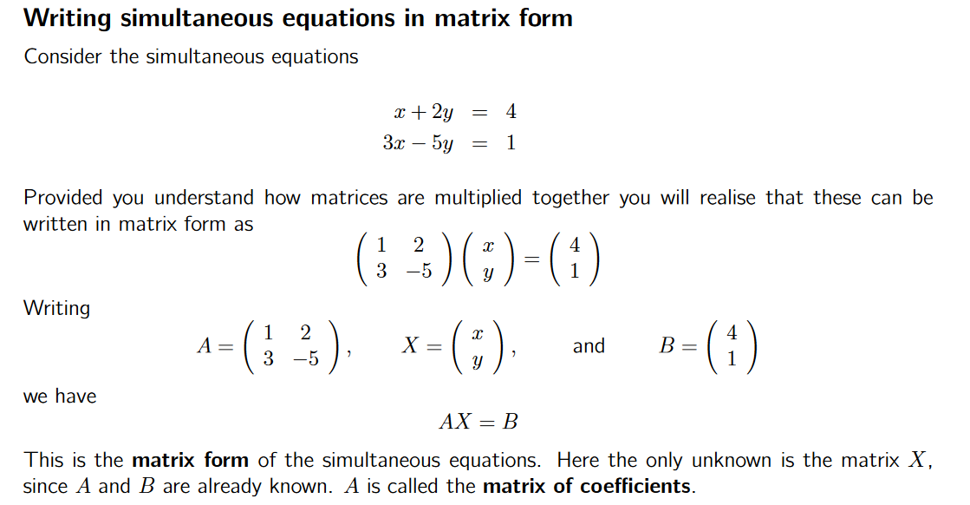

Slide 11
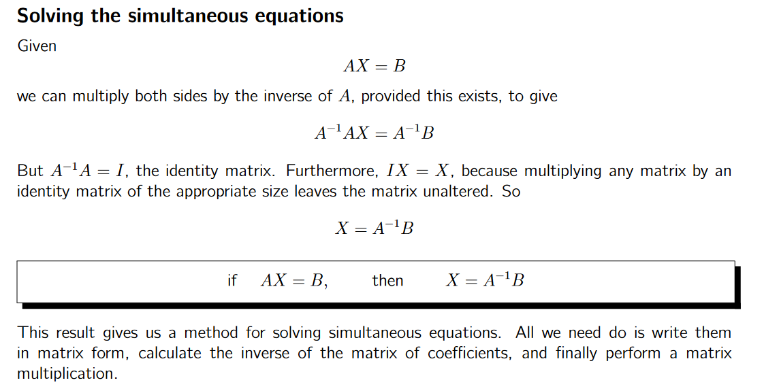
Source: http://www.mathcentre.ac.uk/resources/uploaded/sigma-matrices8-2009-1.pdf

Slide 12
Clues:
import matrix.MatrixCreator;
import matrix.MatrixOperationsInterface;
MatrixOperationsInterface
MatrixOperationsInterface A = MatrixCreator.create(3, 3);
A.setElement(1, 1, 1.6);
insert other elements
Create Matrix B in the same way
insert elements
MatrixOperationsInterface Ainv = A.inverse();
MatrixOperationsInterface x = Ainv.multiply(b);
Print x

Slide 13
compiling/running with -cp
To compile
javac -cp .:<file_1_name>.jar:<file_2_name>.jar <prog_name>.java
To execute
java -cp .:<file_1_name>.jar:<file_2_name>.jar <prog_name>

